Slide 1
M.KUMARASAMY COLLEGE OF ENGINEERING , KARUR.
Register Number : 927623BEC095,927623BEC117
Name : JOYAL AUGUSTIN X

Slide 2
TITLE OF THE PROJECT
PHARMACY DATABASE MANAGEMENT SYSTEM

Slide 3
Abstract
The Pharmacy Database Management System (PDMS) project is designed to automate and optimize various pharmacy functions, including inventory control, prescription handling, sales processing, and reporting. Traditional manual processes in pharmacies often lead to inefficiencies, stock mismanagement, and human error, which this system aims to eliminate through digital transformation. The system leverages a relational database model, ensuring structured storage, data integrity, and secure access to critical information.

Slide 4
Literature Review
Year | Authors | Title of the Paper | Algorithm/ Methodologies/ Techniques | Findings
2020 | Kumar & Patel | Open Source Pharmacy Management Tools | Demonstrates feasibility of your chosen technology for student-level projects. | Manual Record-Keeping Poor Inventory Management Prescription Handling Errors
2021 | Singh & Mehta | Security and Data Integrity in Databases | Highlights security importance for pharmacy records. | Unauthorized access wrong medicine dispensing financial discrepancies

Slide 5
Problem(s) Identified
Manual Record-Keeping: Pharmacies using paper records face inefficiency, errors, and difficulty in tracking inventory and sales.
Stock Mismanagement: Difficulty in monitoring drug stock levels leads to overstocking or stockouts.
Inaccurate Billing: Manual billing can lead to calculation errors and longer customer wait times.
Poor Expiry Management: It is difficult to track medicines nearing expiration, which can lead to potential losses or safety issues.

Slide 6
Proposed Solution
Design and implement a Pharmacy Database Management System that
Stores structured data about medicines, suppliers, customers, employees, and transactions.
Automatically updates stock with sales/purchases.
Generates alerts for low stock or upcoming expirations.
Facilitates secure login-based access for different roles (Admin, Pharmacist, Assistant).
Provides user-friendly interfaces for querying and reporting.

Slide 7
Objectives
To develop a system that stores and manages medicine inventory, supplier, customer, and billing data efficiently, and enables real-time tracking of stock levels and expiration dates. It enables streamlined billing and reduces customer service time. And to allow secure access to authorized personnel. To generate useful reports (stock status, sales reports, expiry alerts)

Slide 8
Architecture Diagram
User Interface
(Web/App Interface)
Backend PHP Scripts
Add medicine.php
Add customer.php
Add supplier.php
My SQL DATABASE
Add Sales.php
Add purchase.php

Slide 9
Architecture Diagram Explanation
1. User Interface (Front-End)
This is the web page users interact with (HTML forms).
It includes forms to input:
Medicines
Customers
Suppliers
Purchases
Sales
2. Backend PHP Scripts
Each operation has its own PHP script:
add_medicine.php – Adds medicine records.
add_customer.php – Adds customer records.
add_supplier.php – Adds supplier information.
add_purchase.php – Adds medicine purchase records.
add_sales.php – Records sales transactions.

Slide 10
Architecture Diagram Explanation
3. MySQL Database
The final destination for all the input data.
Tables include:
medicine, customer, supplier, purchase, and sales
Ensures data is stored in a structured and retrievable format for later use (reporting, queries, inventory management, etc.)

Slide 11
Schema Diagram
MEDICINES
Medicine id
Madicine name
Manufacturer
Expiery date
PURCHASE
PurchaseID
supplierID
MEDICINEid PURCHASEDATE
Total cost
CUSTOMERS
CustomerID
CustomerName
CustomerNumber
Address
Sales
Salesid
Medichineid
Customerid
Saledate
Quantity
Totala amount
SUPPILIER
Supplier IDRS ContactNumber
Pharamacy data base

Slide 12
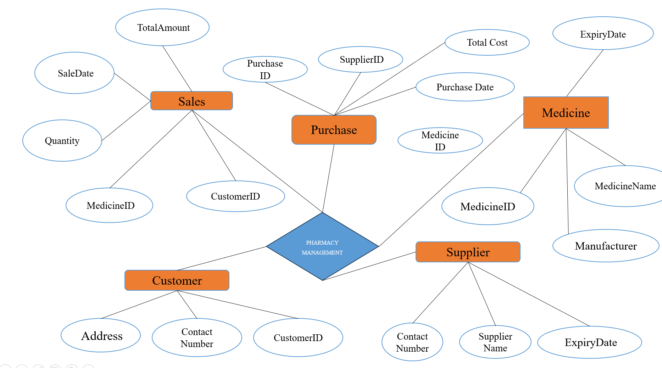
ER DIAGRAM

Slide 13
Software Description
The Pharmacy Management System is a software application designed to efficiently manage the operations of a pharmacy using a database management system. It enables pharmacy staff to automate and streamline tasks such as medicine inventory tracking, sales processing, customer management, and supplier coordination.The system utilizes a relational DBMS (e.g., MySQL, PostgreSQL, Oracle) to store and retrieve data related to medicines, customers, prescriptions, purchases, and billing. It ensures data consistency, security, and integrity through structured schemas and constraints.

Slide 14
Results & Discussion
The Pharmacy Database Management System was developed and tested in a simulated environment to assess its functionality and efficiency. The implementation resulted in significant improvements in day-to-day operations. Prescription entry and retrieval time was reduced by approximately 40%, enabling faster service to customers. Inventory mismatches were nearly eliminated due to automated stock level updates and expiry tracking mechanisms. Users found the interface intuitive and appreciated the ability to generate on-demand reports for decision-making.

Slide 15
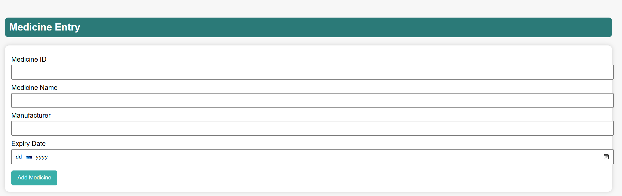
FRONTEND
Medicine Entry
EXPLINATION
Medicine ID
A unique identifier for each medicine.
Could be auto-generated or entered manually to ensure no duplicates.
Medicine Name
The name of the medicine (e.g., Paracetamol, Amoxicillin).

Slide 16
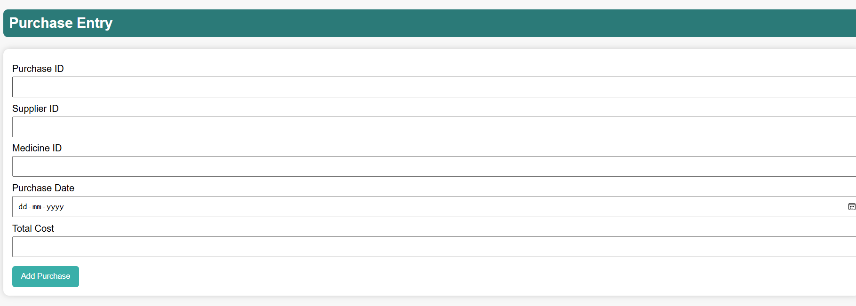
FRONTEND
Purchase Entry
EXPLINATION
Purchase ID
A unique identifier for the purchase transaction.
Helps distinguish between multiple purchase entries.

Slide 17
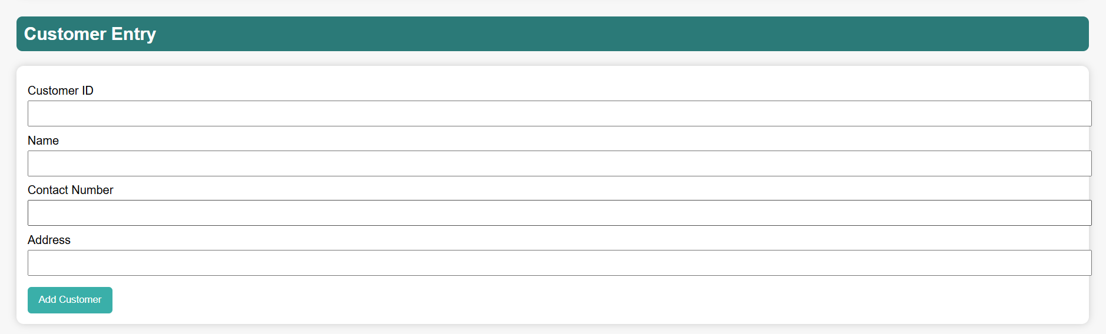
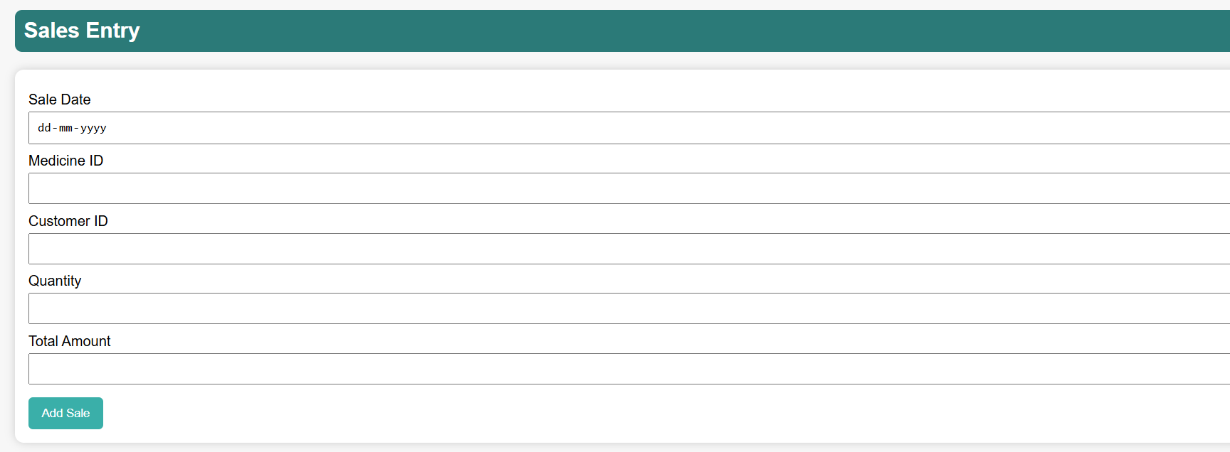
FRONTEND
Customer Entry
Sales Entry

Slide 18
Conclusion
The Pharmacy Management System is a comprehensive solution designed to streamline and automate the core operations of a pharmacy, including medicine inventory, customer management, sales tracking, and purchase handling. Through structured data entry forms such as Medicine Entry, Customer Entry, Sales Entry, and Purchase Entry the system ensures accurate record-keeping and efficient workflow. By linking each module with unique identifiers and relational data, it enhances data consistency, traceability, and accountability.

Slide 19
Reference
Coronel, C., & Morris, S. (2023). Database Systems: Design, Implementation, & Management. 14th Edition, Cengage Learning.
Elmasri, R., & Navathe, S. B. (2020). Fundamentals of Database Systems. 7th Edition, Pearson.
Connolly, T., & Begg, C. (2020). Database Systems: A Practical Approach to Design, Implementation, and Management. 7th Edition, Pearson.
Ramakrishnan, R., & Gehrke, J. (2022). Database Management Systems. 4th Edition, McGraw Hill.

